Slide 1

Online health status detection of a motor
MAS513-Advanced Robotics project:
PROBLEM: Is it possible to determine the health status of the motor continuously using non-contact sensors ad non-destructive testing?
Gianluca Salata, 25/08/2021

Slide 2
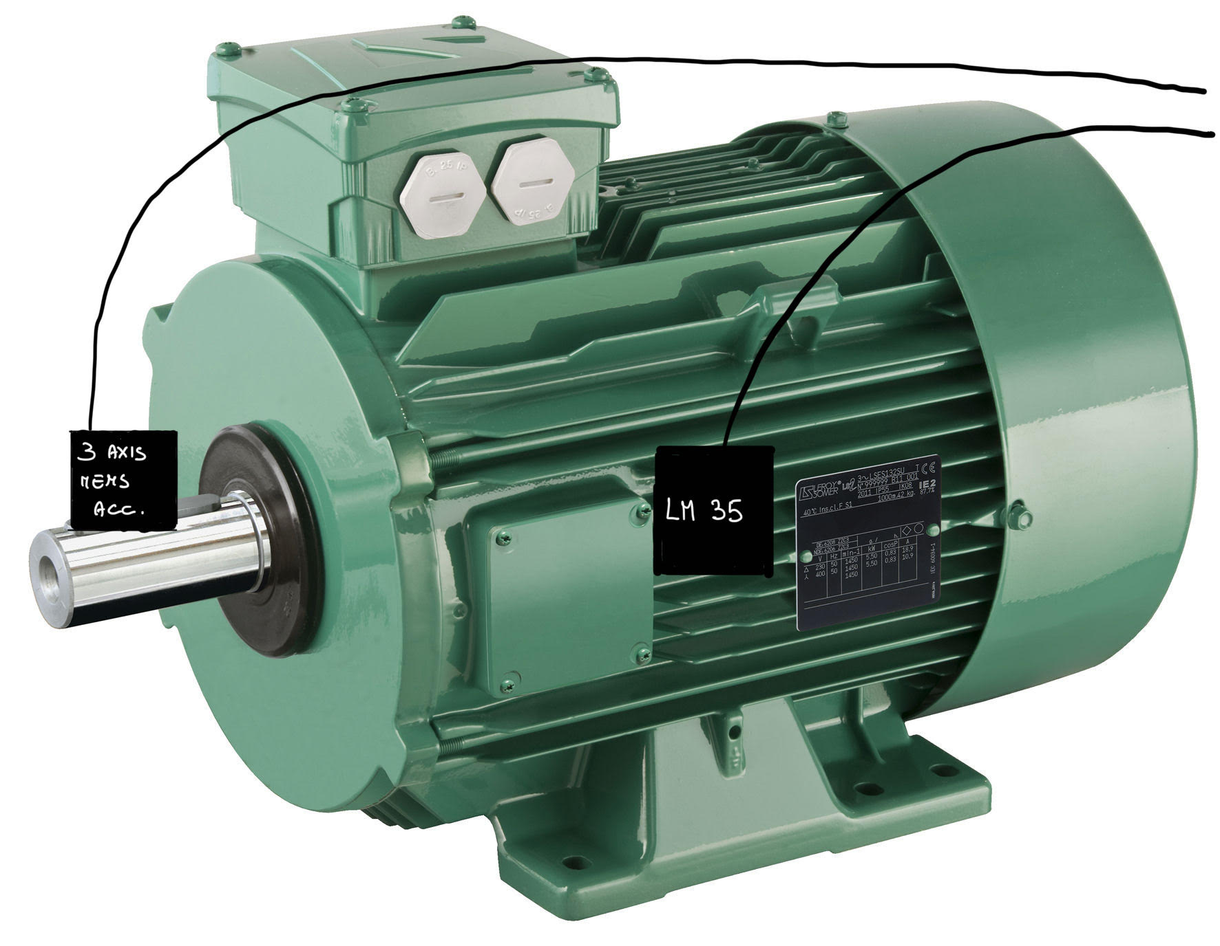
State of art:
Detection of the health status of the motor using contact sensor such as:
Temperature sensor
Vibrometer/accelerometer
Voltmeter and ammeters
Can estimate the remaning useful life of the motor using contact sensors and an artificial neural network combined with a fuzzy logic.
Estim.
useful
life
Temperature
bearings
defects
Gianluca Salata, 25/08/2021

Slide 3
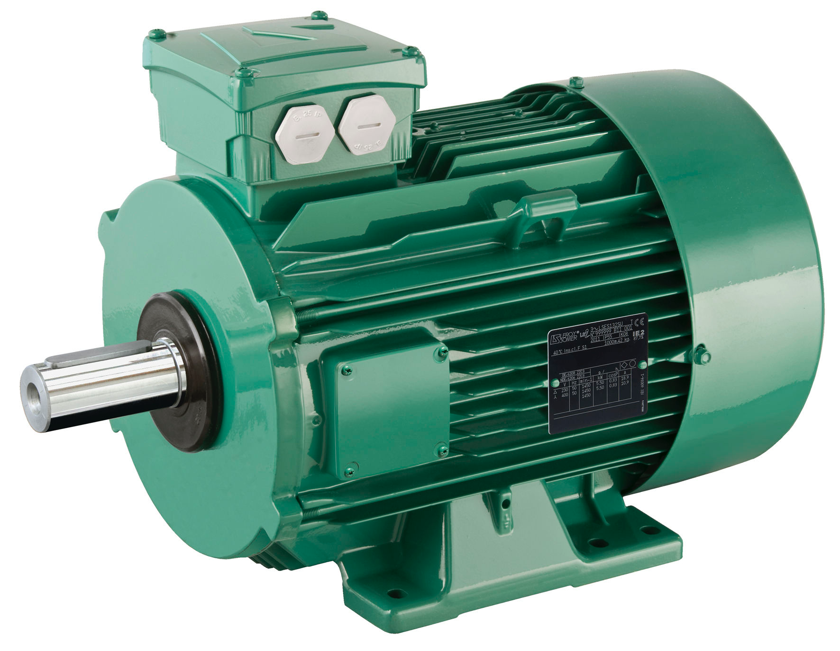
Project’s aim
The aim is to determine the continous health status of the motor using a non-contact sensors that measure the speed of the motor.
LIDAR
PROS:
Non intrusive monitoring system
Mostly independet from enviroment condition
Retrace the fault
ANN
GOOD
BAD
Gianluca Salata, 25/08/2021

Slide 4
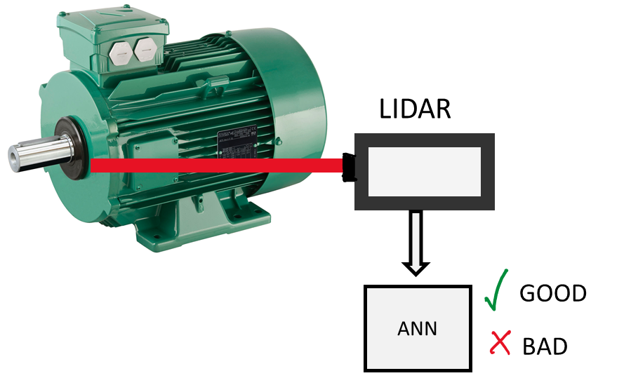
Process
Lidar read the speed of the motor’s shaft
The speed data is processed
Training is based on the inejection of known fault, varying current and load
An ANN elaborated the data and determine the healt status
Retrace the fault using reverse engineering
Gianluca Salata, 25/08/2021

Slide 5
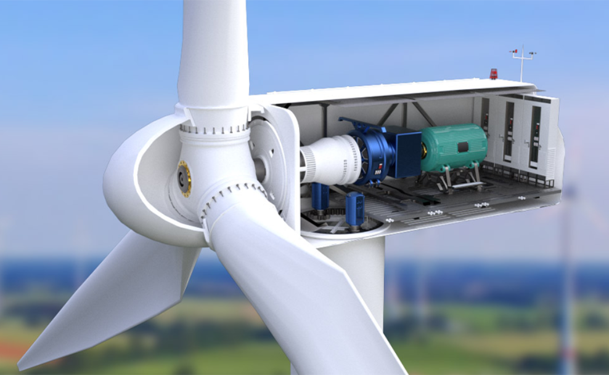
Future applications and developments
Condition monitoring without contact with the object can be very useful when the motor is placed in hostile or not very accesable enviroment.
The data from the sensing components can be used for the control system of the motor, improving efficiency.
The health of the motor can helps to develop new predictive maintenance technique, reducing the costs of industrial installations.
Gianluca Salata, 25/08/2021

